Slide 1
P²Net:Patch-match and Plane-regularization for Unsupervised Indoor Depth Estimation
Team Eragon

Slide 2
Approach
Unsupervised depth estimation
Extract discriminative keypoints with large local gradients and use patches centered at each point as its representation
patch-match: A patch-based warping process that assumes the same depth for pixels within a local patch is proposed for a more robust matching.
plane- regularization: we propose to use superpixels to represent those homogeneous-texture or non-texture piecewise planar regions and regularize the depth consistency within each superpixel.
This approach is most suitable for indoor scene depth estimation

Slide 3
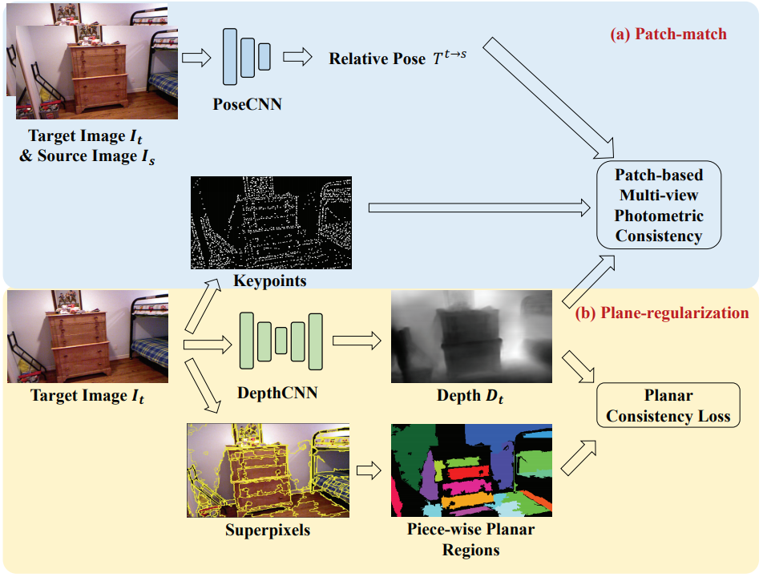
Method
The P²Net contains of the following modules:
Two learnable modules:
Depth CNN
Pose CNN
Patch-match Module
Plane-regularization Module
Overall network architecture of the P²Net

Slide 4
Superpixels - algorithms
To generate superpixels, we evaluate the following 2 algorithms :
SLIC
Felzenszwalb (used in the paper)
We vary the hyperparameters and evaluate the results qualitatively.

Slide 5
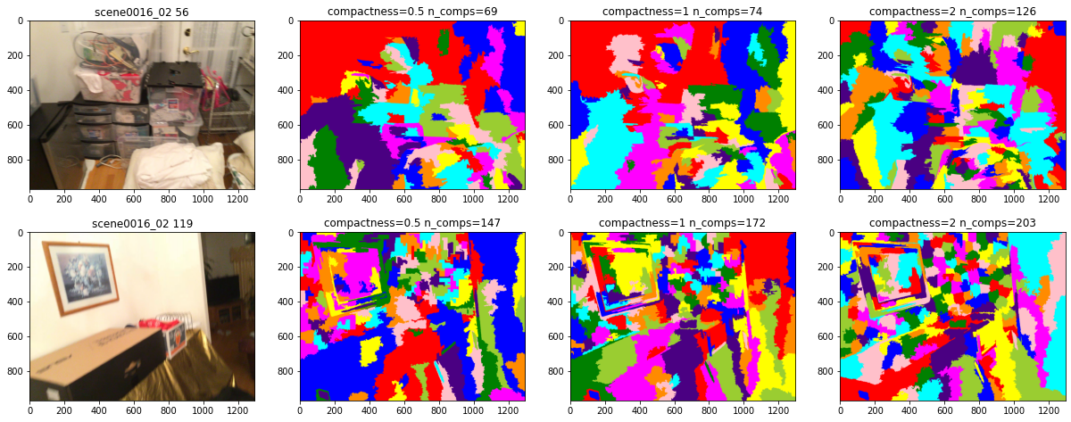
Superpixels - SLIC
Number of segments - 500

Slide 6
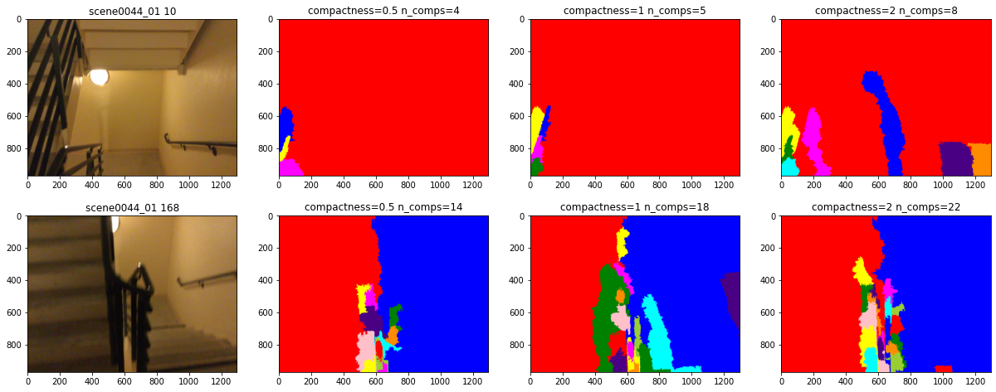
Superpixels - SLIC
Number of segments - 500

Slide 7
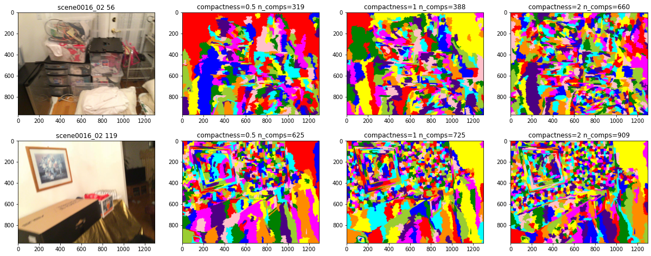
Superpixels - SLIC
Number of segments - 2000

Slide 8
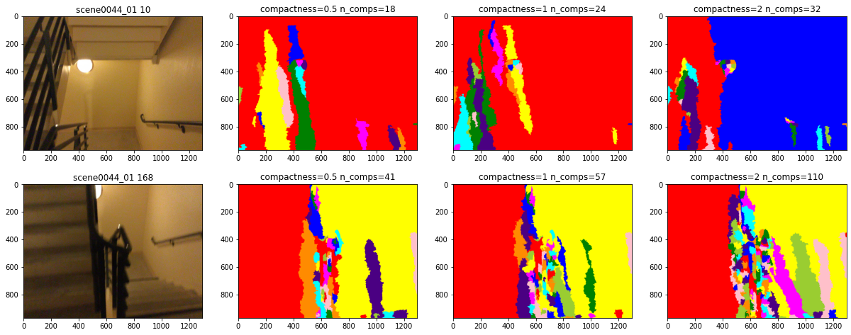
Superpixels - SLIC
Number of segments - 2000

Slide 9
Superpixels - SLIC
The previous results highlight the shortcomings of SLIC:
The generated superpixels capture the textureless regions in either extremely dense or sparse manner.
The generated superpixels do align themselves along the planar surfaces and ,hence, are not useful for enforcing the planarity constraints.

Slide 10
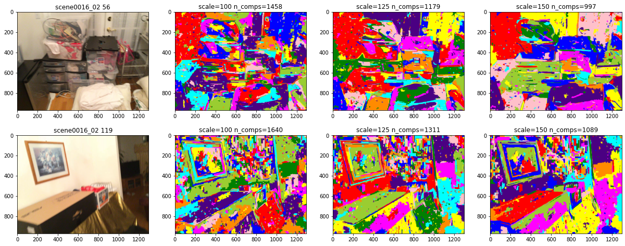
Superpixels - Felzenszwalb
Varying scale parameter

Slide 11
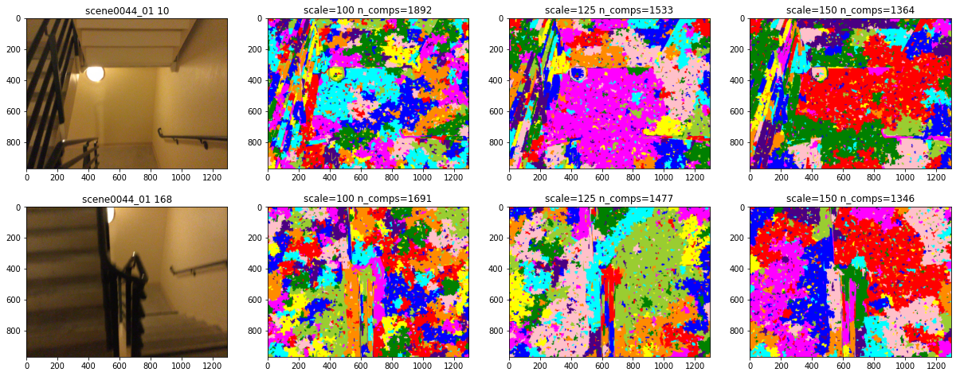
Superpixels - Felzenszwalb
Varying scale parameter

Slide 12
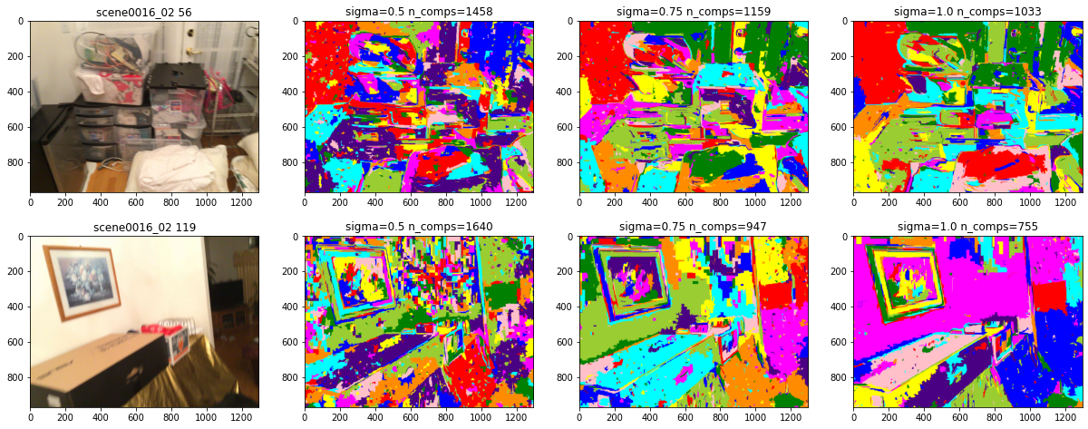
Superpixels - Felzenszwalb
Varying sigma parameter

Slide 13
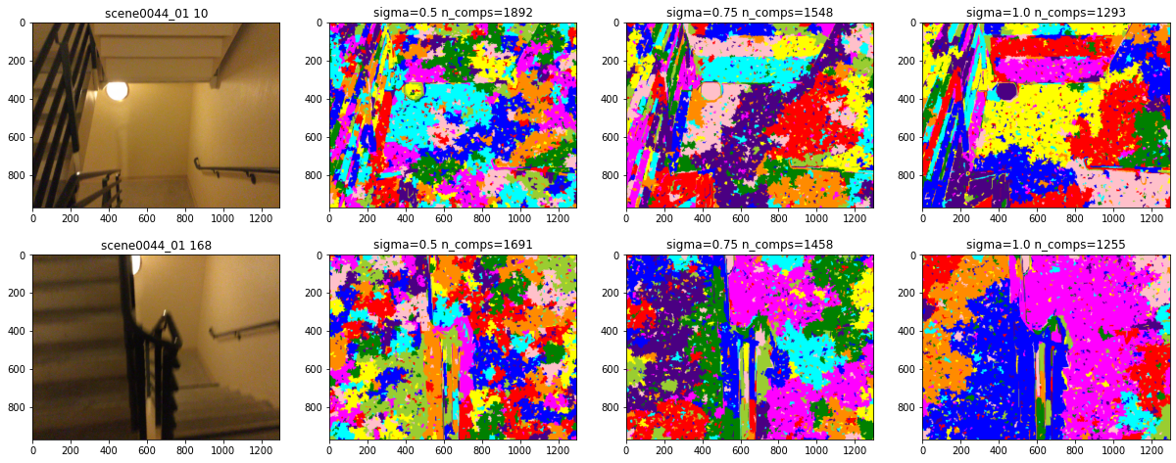
Superpixels - Felzenszwalb
Varying sigma parameter

Slide 14
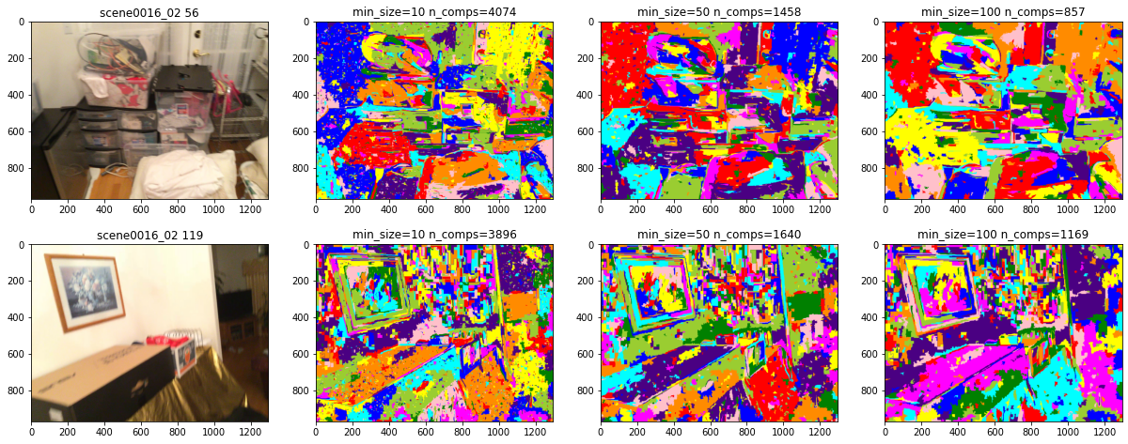
Superpixels - Felzenszwalb
Varying min_size parameter

Slide 15
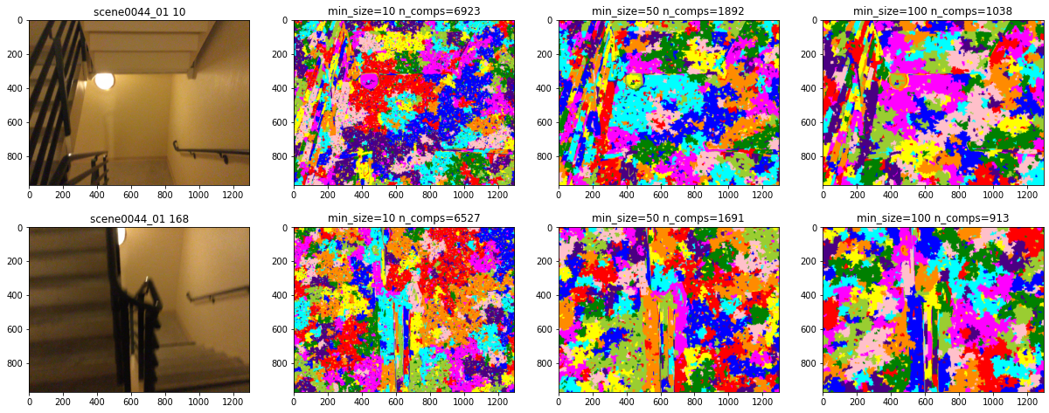
Superpixels - Felzenszwalb
Varying min_size parameter

Slide 16
Superpixels - Felzenszwalb
The previous results highlight the following advantages of Felzenszwalb:
The generated superpixels are generated much more evenly in textureless regions across images.
The superpixels are also aligned along the surfaces.
There are also shortcomings of this algorithm:
In textureless regions, the superpixels are still overly fragmented and noisy.
The superpixels sometimes span across two surfaces over an edge, such as walls, if they have very similar textures. This will be problematic since it will force the two surfaces to be planar and lead to incorrect supervision.

Slide 17
Experiments
We train the following 4 models for our experiments:
Base Model - based on Monodepthv2
Sparse Keypoints - Using patch match but keeping the number of keypoints <= 100.
No Planar Constraint - Using dense patch match on 3000 keypoints but not enforcing any superpixel based planarity constraint.
Indoor SFM - Using dense patch match along with superpixels planarity constraint.
In addition to the above, we also use a pre-trained MiDaS model for evaluation since it was covered as part of the course.

Slide 18
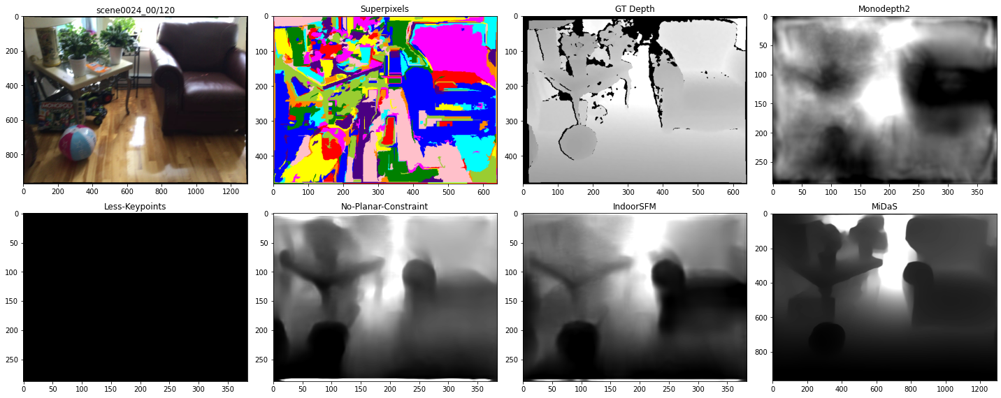
Results
IndoorSFM has better sofa seat depth but the pots on the left are smudged.

Slide 19
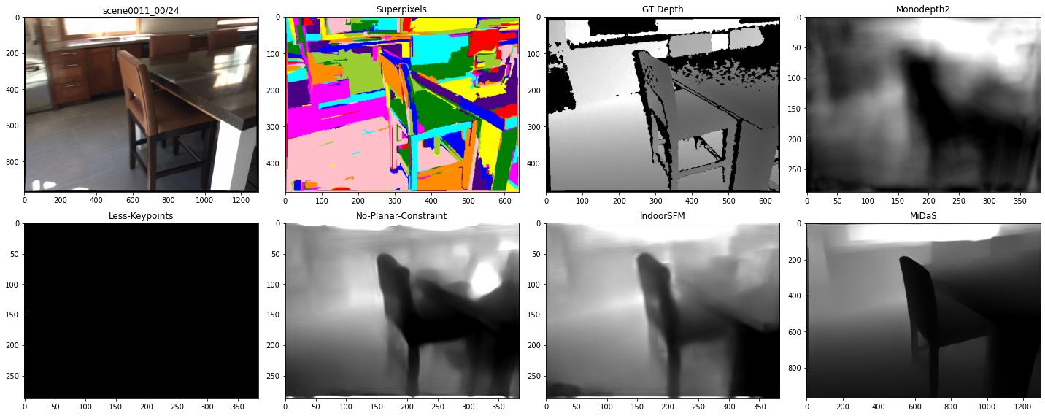
Results
IndoorSFM does better on the table top surface in dealing with reflection.

Slide 20
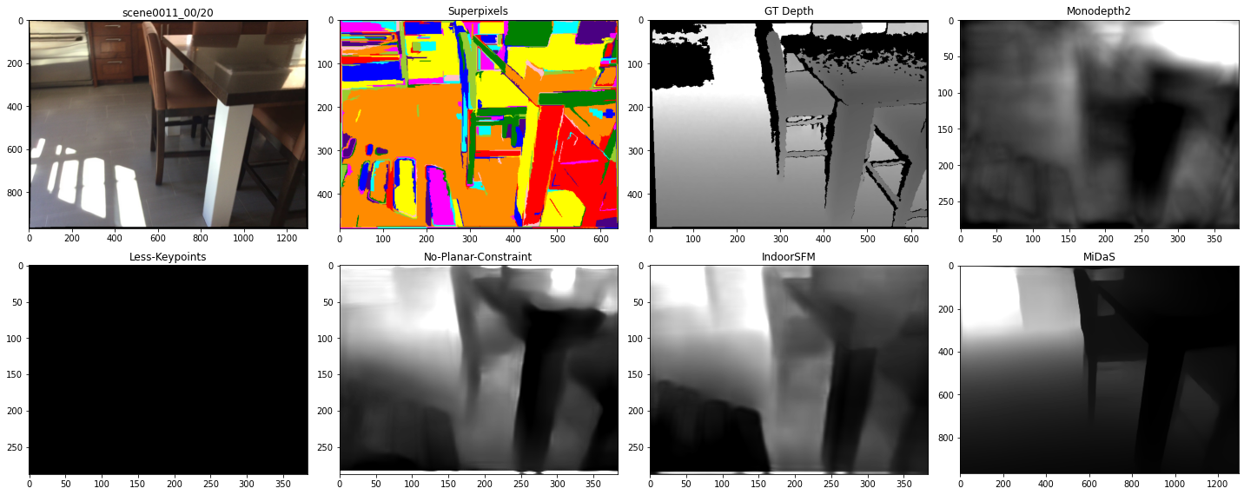
Results
IndoorSFM does poorly with the floor surface in dealing with reflection.

Slide 21
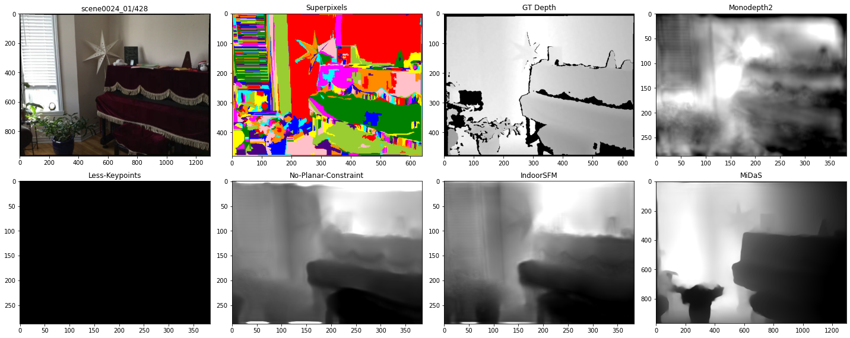
Results
IndoorSFM does better with depth prediction for the walls.

Slide 22
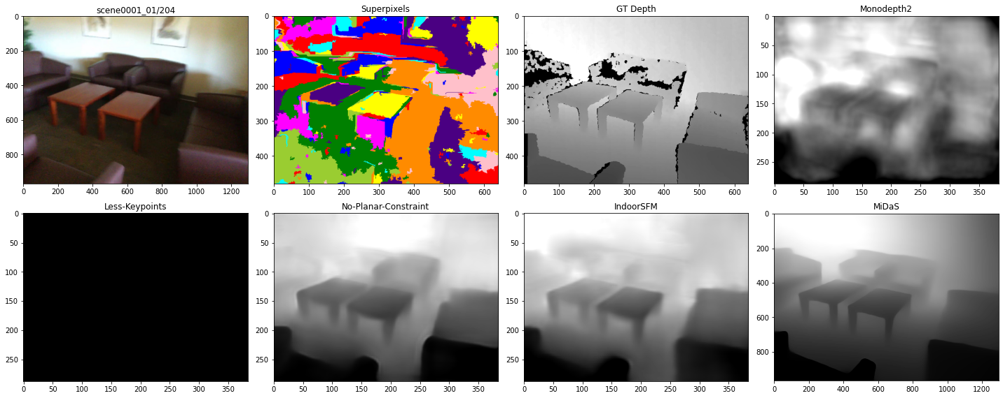
Results
IndoorSFM has better wall depth prediction but the sofa is smudged.

Slide 23
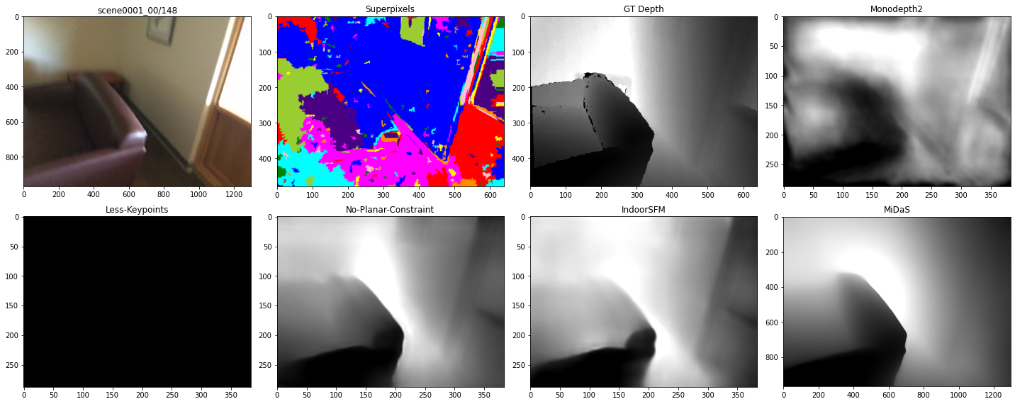
Results
IndoorSFM suffers at the sofa arm rest depth prediction

Slide 24
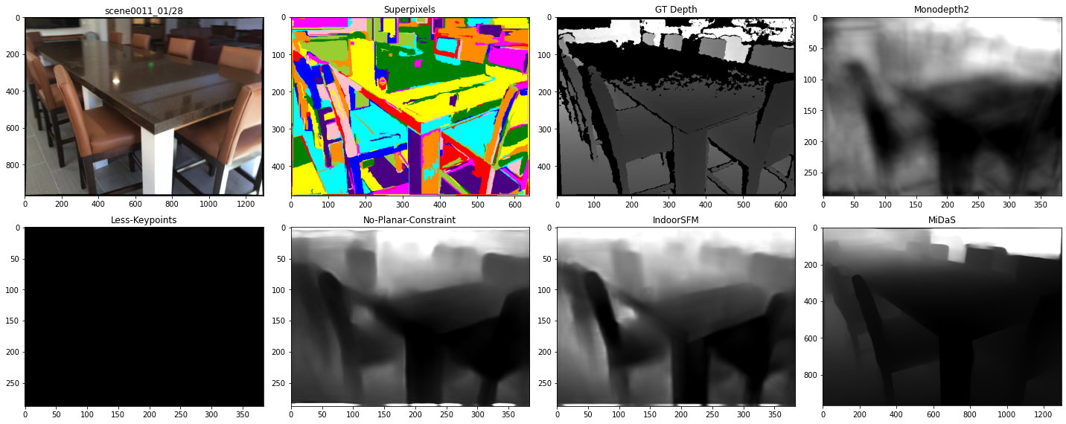
Results
IndoorSFM suffers in dealing with translucent surfaces.

Slide 25
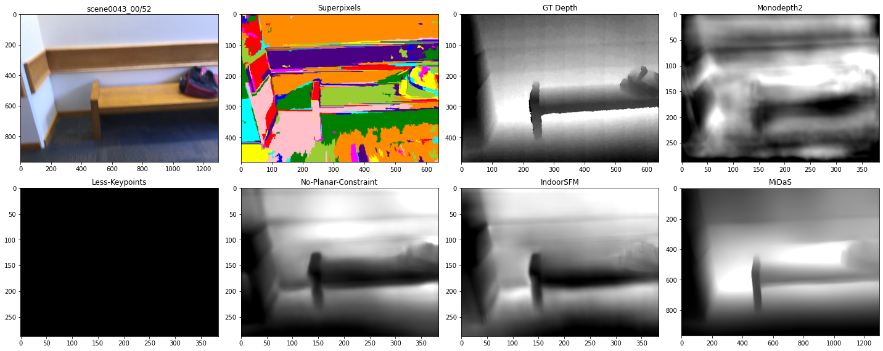
Results
IndoorSFM is unable to predict a consistent planar depth for the wall.

Slide 26
Evaluation
 | abs_rel | sq_rel | rmse | rmse_log | a1 | a2 | a3
Monodepthv2 | 0.203 | 0.178 | 0.588 | 0.252 | 0.693 | 0.902 | 0.966
Less Keypoints | 0.26 | 0.268 | 0.732 | 0.315 | 0.603 | 0.831 | 0.928
No Planar Const. | 0.184 | 0.302 | 0.724 | 0.239 | 0.77 | 0.942 | 0.978
IndoorSFM | 0.163 | 0.115 | 0.501 | 0.207 | 0.774 | 0.942 | 0.984
MiDaS | 0.229 | 0.425 | 1.022 | 0.269 | 0.7 | 0.893 | 0.958
IndoorSFM Paper | 0.147 | - | 0.553 | 0.062 | 0.801 | 0.951 | 0.987
IndoorSFM performs better than all other models.
Our scores are close to the ones reported in the P2-Net paper.

Slide 27
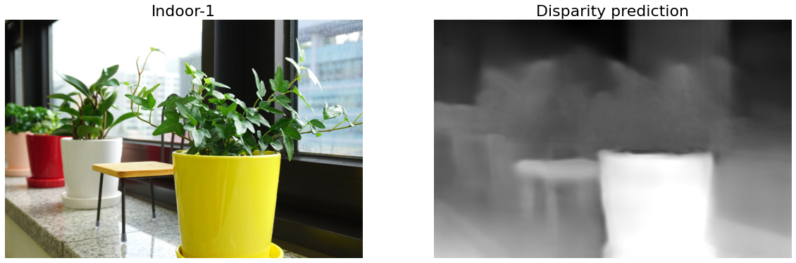
Prediction - Custom Image 1
IndoorSFM isn’t able to predict for the foliage properly.

Slide 28
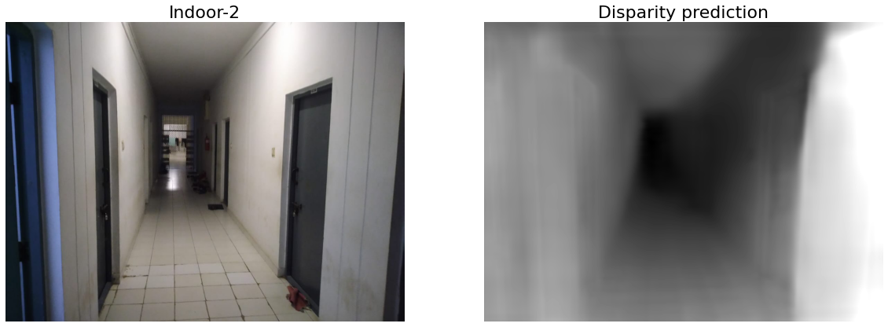
Prediction - Custom Image 2
IndoorSFM isn’t able to predict wall depth consistently due to improper lighting

Slide 29
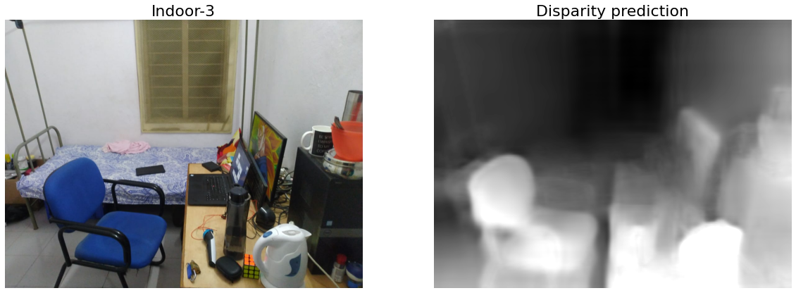
Prediction - Custom Image 3
IndoorSFM doesn’t have sharp object boundaries in the predicted depth.

Slide 30
Conclusion
From the previous qualitative and quantitative results, we can infer the following:
Using keypoints based dense patch matching along with planarity constraints gives better results in Indoor environments.
The quality of the result is directly dependent on the quality of superpixels being used to enforce the planarity constraints during training.
The output suffers from blurred and soft edges, despite doing multiscale loss computation. MiDaS does better here since it has a scale and shift invariant gradient matching term that utilizes ground truth depth in its loss function and hence has better supervision.

